Slide 1
5G – Are you prepared for the change?
“5G – or 5th generation – technology is much more than just the next generation of connectivity and Internet.” – ICTC, 2018

Slide 2
Introduction
5G has the potential to bring innovative technologies that were not possible with 4G-LTE. Naturally, it is going to cause major changes in all industries.
What should you do as a retailer to take advantage of the “20 times faster than the current 4G-LTE connections”?
5G in IoT, AR/VR technology, and with AI has the potential to upgrade the experience of buying products and services in-store and online.
Educating your employees of 5G and conducting brainstorming sessions to discuss the potential use cases of 5G in your business will keep you a step ahead of your competition.

Slide 3

Analysis Methodology
Analysis
The direct and indirect impacts of 5G on a customer’s user experience will be discussed using information from the ICTC’s report, 5G: Jumpstarting Our Digital Future.
Three areas that could have the biggest impact on the retail industry will be evaluated.
Internet of Things (IoT)
Augmented Reality and Virtual Reality
Artificial Intelligence and Machine Learning
Criteria
How will application of 5G in the above technologies change user experience?
Assumptions
The above topics will have the biggest impact on retail businesses.
Improving user experience is the best way to improve customer acquisition and retention.

Slide 4
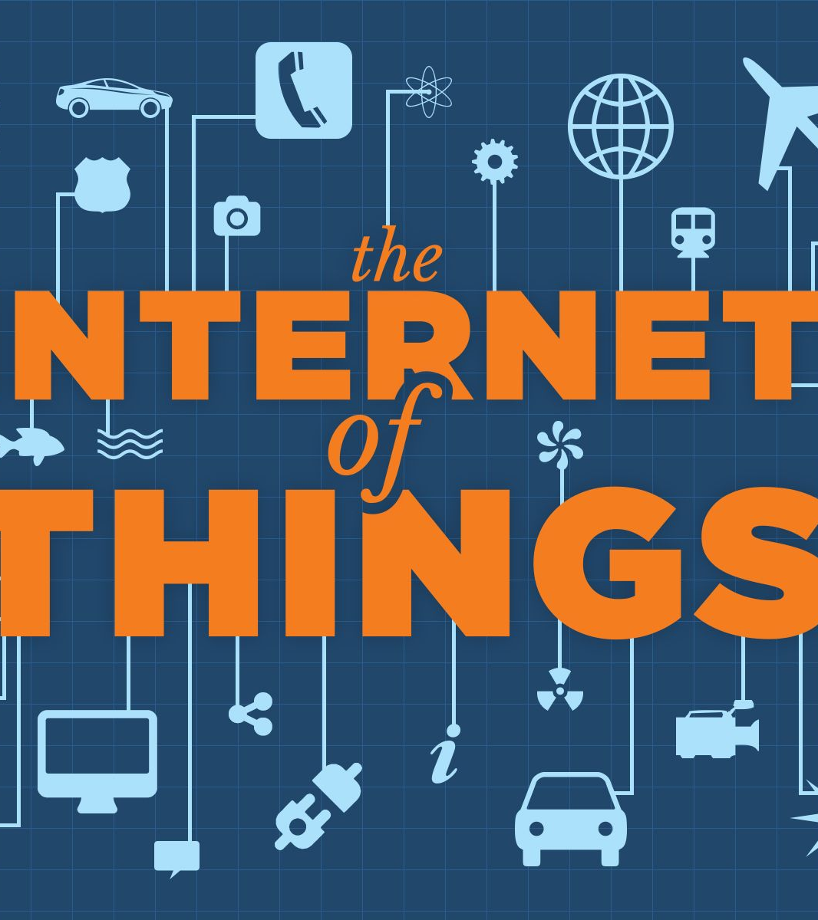
Argument 1 - IoT
5G in IoT will enable faster data transfers between devices, creating a better user experience.
Example: Better check-out experience
This Photo by Unknown Author is licensed under CC BY-SA

Slide 5
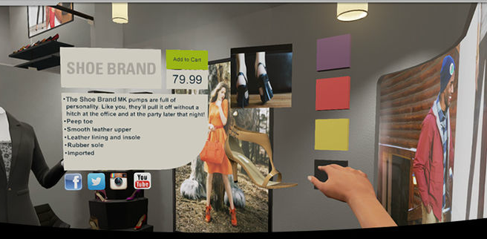
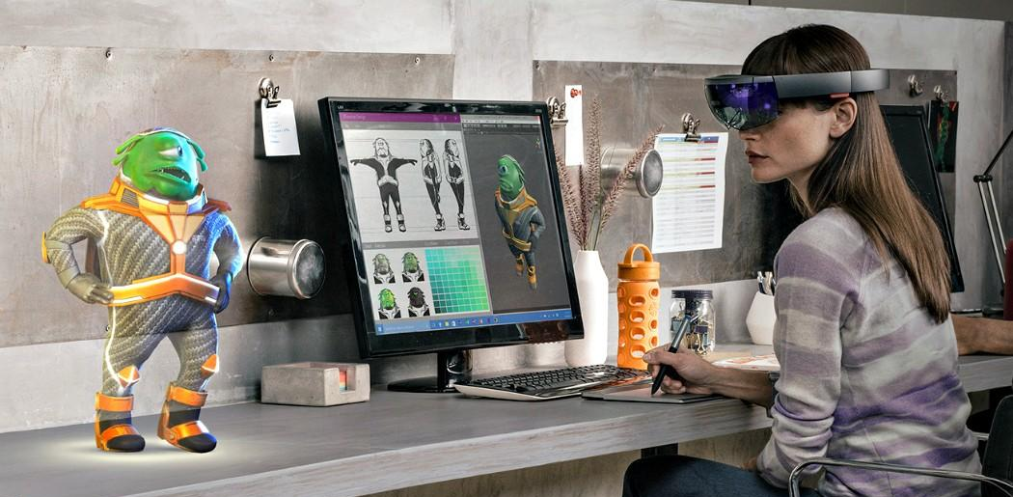
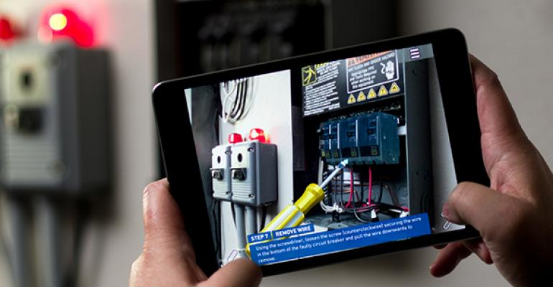
Argument 2 – AR/VR
5G in AR/VR has the potential to introduce new ways of customer service.
Example: AR/VR technology can be used to navigate a store and its products from the comfort of one’s home.
This Photo by Unknown Author is licensed under CC BY-SA-NC
This Photo by Unknown Author is licensed under CC BY-SA-NC
This Photo by Unknown Author is licensed under CC BY-SA-NC

Slide 6
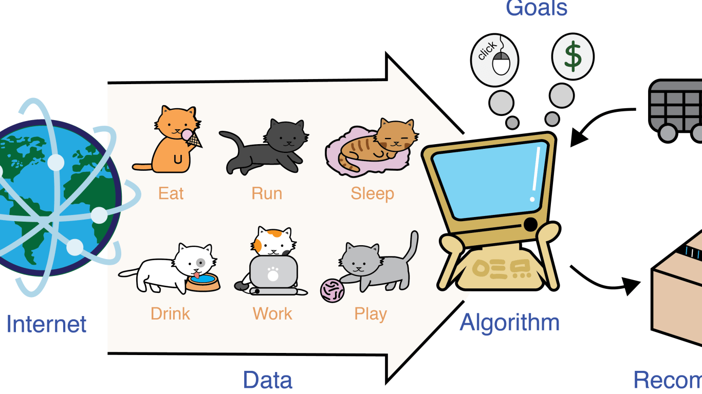
Argument 3 - AI
5G will enable numerous machine learning applications to reach a consumer with a combination of low latency and cloud computing.
Example: faster and better image search results when shopping online.
Whether it is the deployment of autonomous vehicles or crop monitoring applications, 5G and Machine Learning can enhance existing processes and introduce applications that were not thought of before.
This Photo by Unknown Author is licensed under CC BY-SA-NC

Slide 7
Conclusion
5G combined with technologies like IoT, AR/VR and AI has the capability to transform user experience in a way described in sci-fi movies.
To keep up with the industry and a step ahead your competitors, it is necessary to prepare for the technological revolution.

Slide 8
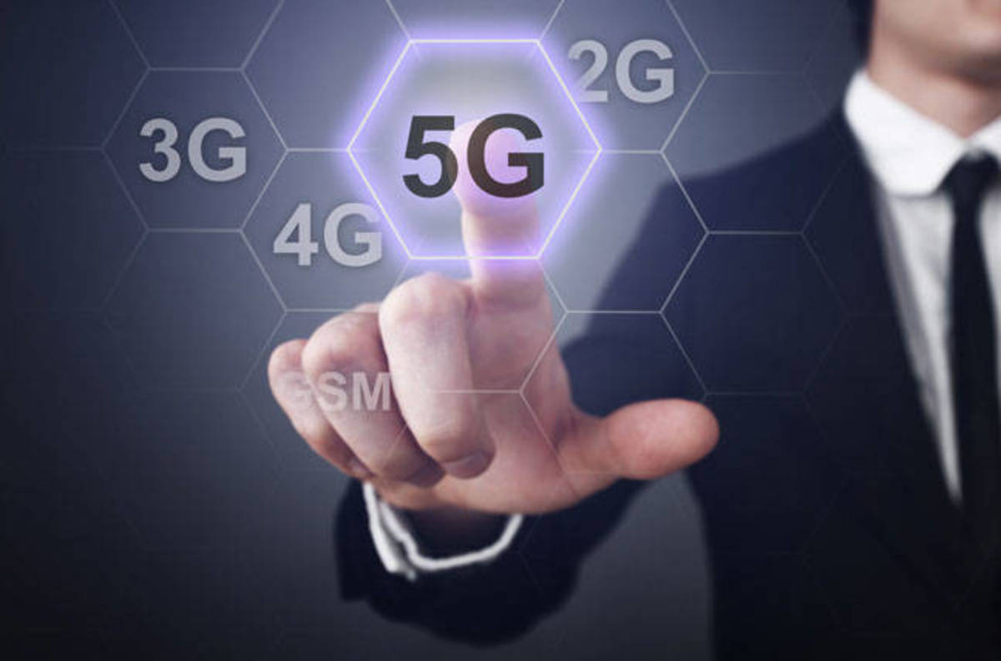


Recommendation
This Photo by Unknown Author is licensed under CC BY-NC
Educate your team of the 5G technology.
Evaluate how 5G can improve your product and services – most of all the user experience.
Working on integrating 5G-enabled technology in your business now will keep you a step ahead of your competition.
This Photo by Unknown Author is licensed under CC BY
This Photo by Unknown Author is licensed under CC BY-SA

Slide 9
References
Davidson, R., McLaughlin, R. (2018). 5G: Jumpstarting Our Digital Future. Information and Communications Technology Council (ICTC). Ottawa, Canada.
https://www.digitalcommerce360.com/article/e-commerce-sales-retail-sales-ten-year-review/

